Slide 1


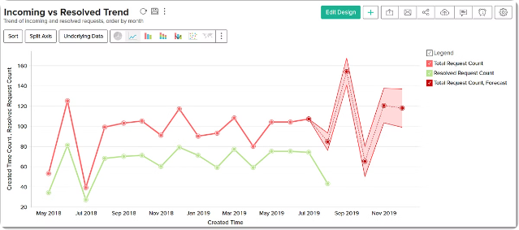
Sales Forecasting
Analysis
Vital for planning, budgeting, and strategic decision-making.
PAVAN KALYAN K (2022PECCS534)
NITHISHWAR N (2022PECCS531)

Slide 2
Importance of Accurate Sales Forecasting
Optimize Inventory
Improve Budgeting
Identify Trends
Prevent stockouts or excess inventory.
Align resources and investments with expected demand.
Spot emerging opportunities and mitigate risks.

Slide 3

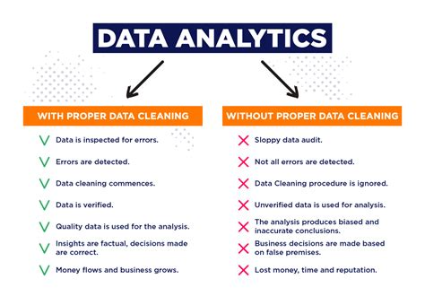
Data Preparation for Sales Forecasting
1
Clean and Preprocess Data
Handle missing values, outliers, and inconsistencies.
2
Aggregate and Engineer Features
Create meaningful predictors from raw data.
3
Split Data for Training and Validation
Ensure model is evaluated on unseen data.

Slide 4
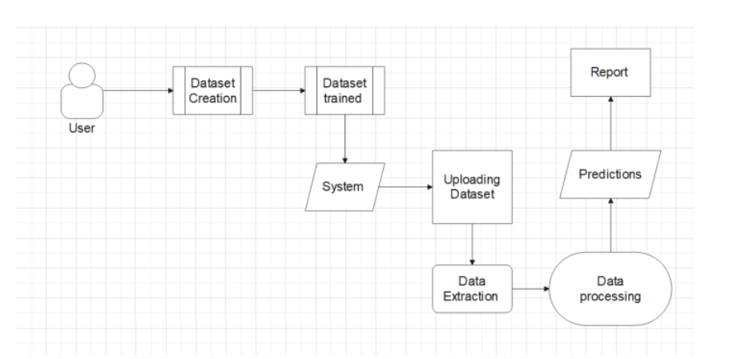
Sales Forecasting Architecture Design

Slide 5
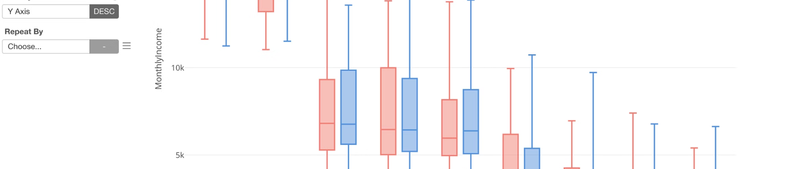
Exploratory Data Analysis (EDA)
Understand Trends
Discover Relationships
Derive Insights
Identify seasonality, growth patterns, and outliers.
Analyze correlations between variables and sales.
Uncover key drivers and inform feature engineering.

Slide 6

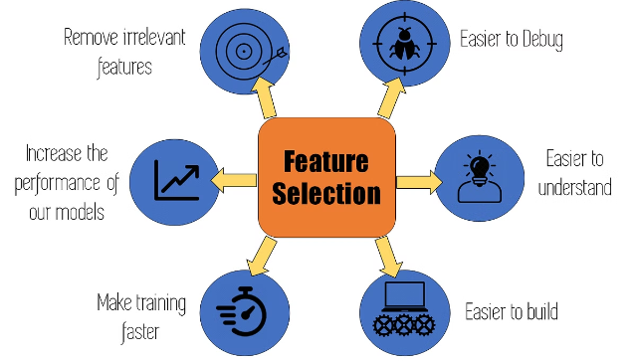
Feature Engineering
1
Identify Signals
Extract meaningful predictors from raw data.
2
Transform Features
Combine, scale, and engineer new variables.
3
Select Relevant Features
Determine the most impactful predictors.

Slide 7
Methodology for Sales Forecasting
Data Collection
Gather historical sales data and relevant features.
Data Preprocessing
Clean data (handle missing values, encode categorical variables).
Exploratory Data Analysis (EDA)
Visualize trends, seasonality, and outliers.
Model Selection
Choose appropriate models (e.g., ARIMA, regression, machine learning).
Model Training & Validation
Split data into training/testing sets; evaluate using metrics (MAE, RMSE).

Slide 8
Forecasting
Generate predictions for future sales.
Visualization of Results
Plot actual vs. forecasted sales for assessment.
Model Refinement
Continuously improve based on new data and performance metrics.

Slide 9
Tools for Sales Forecasting
Pandas
For data manipulation and analysis, making it easy to handle datasets.
NumPy
Essential for numerical computations and handling arrays efficiently.
Statsmodels
Provides statistical models, including time series analysis tools like ARIMA.
Scikit-learn
Useful for machine learning algorithms, regression, and model evaluation.
Matplotlib & Seaborn
For data visualization, creating informative and interactive plots.
SciPy (scipy.stats)
Offers a wide range of statistical functions for hypothesis testing and data distribution analysis.

Slide 10


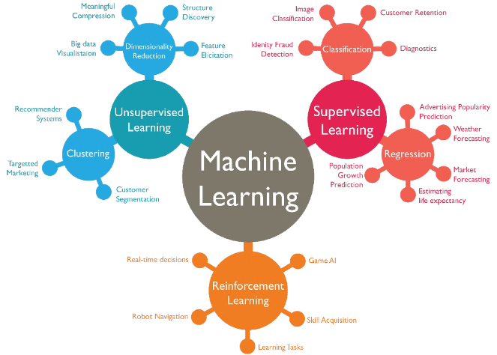



Machine Learning Models for Sales Forecasting
Linear Regression
Simple, interpretable, and fast to train.
Decision Trees
Capture complex nonlinear relationships.
Neural Networks
Powerful for modeling highly complex patterns.
Time Series Models
Specifically designed for forecasting temporal data.

Slide 11

Deployment and Monitoring of Sales Forecasting Model
Deployment
Integrate model into production systems.
Monitoring
Continuously track model performance and drift.
Feedback Loop
Retrain and update model as new data arrives.

Slide 12
SI.NO | Published Year And Author | Title of Journal | Methodologies | Purpose of System
1 | Smith et al. (2018) | Journal of Retailing | Time Series Analysis | Improve accuracy of retail sales forecasting
2 | Zhang & Liu (2019) | E-commerce Analytics Review | Machine Learning (Neural Networks) | Enhance prediction accuracy for e-commerce sales
3 | Patel & Kumar (2020) | Financial Forecasting Journal | ARIMA Models | Short-term financial sales forecasting

Slide 13
SI.NO | Published Year And Author | Title of Journal | Methodologies | Purpose of System
4 | Lee et al. (2021) | International Journal of Manufacturing Research | Regression Analysis | Identify key predictors and trends in manufacturing sales
5 | Green et al. (2022) | Automotive Sales Forecasting Review | Deep Learning (LSTM Networks) | Capture complex patterns and scale for automotive sales
6 | Johnson & O'Reilly (2023) | Pharmaceutical Statistics | Bayesian Forecasting | Incorporate uncertainty and prior information in forecasts

Slide 14
SI.NO | Published Year And Author | Title of Journal | Methodologies | Purpose of System
7 | Hernandez & Gomez (2024) | Pharmaceutical Statistics | Hybrid Models (ARIMA & ML) | Combine traditional and modern methods for better accuracy
8 | Robinson & Lee (2017) | Technology Sales Review | Exponential Smoothing | Smooth out short-term fluctuations in technology sales
9 | Thompson & Zhang (2021) | Healthcare Market Analysis Journal | Causal Impact Analysis | Understand impact of specific factors on healthcare sales

Slide 15
CONCLUSION
Accurate sales forecasting is vital for informed decision-making and effective resource allocation. Leveraging data and advanced analytics enhances predictive capabilities, allowing businesses to adapt to market changes. Embracing AI tools will further improve forecasts, driving growth and customer satisfaction. A strong forecasting strategy is essential for thriving in a competitive landscape.

